Slide 1
Cost-Volume-Profit Relationships
Notes:
3-<number>
Cost-volume-profit (CVP) analysis helps managers understand the interrelationships among cost, volume, and profit by focusing their attention on the interactions among the prices of products, volume of activity, per unit variable costs, total fixed costs, and mix of products sold. It is a vital tool used in many business decisions such as deciding what products to manufacture or sell, what pricing policy to follow, what marketing strategy to employ, and what type of productive facilities to acquire.

Slide 2

Learning Objective 1
Explain how changes in activity affect contribution margin and net operating income.
Notes:
3-<number>
Learning objective number 1 is to explain how changes in activity affect contribution margin and net operating income.

Slide 3

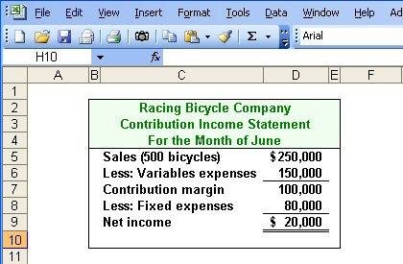
Basics of Cost-Volume-Profit Analysis
Contribution Margin (CM) is the amount remaining from sales revenue after variable expenses have been deducted.
Notes:
3-<number>
The contribution income statement is helpful to managers in judging the impact on profits of changes in selling price, cost, or volume. For example, let's look at a hypothetical contribution income statement for Racing Bicycle Company (RBC). Notice the emphasis on cost behavior. Variable costs are separate from fixed costs. The contribution margin is defined as the amount remaining from sales revenue after variable expenses have been deducted.

Slide 4
Basics of Cost-Volume-Profit Analysis
CM is used first to cover fixed expenses. Any remaining CM contributes to net operating income.
Notes:
3-<number>
Contribution margin is used first to cover fixed expenses. Any remaining contribution margin contributes to net operating income.

Slide 5
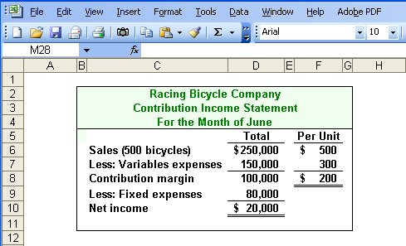
The Contribution Approach
Sales, variable expenses, and contribution margin can also be expressed on a per unit basis. If Racing sells an additional bicycle, $200 additional CM will be generated to cover fixed expenses and profit.
Notes:
3-<number>
Sales, variable expenses, and contribution margin can also be expressed on a per unit basis. For each additional unit Racing Bicycle Company sells, $200 more in contribution margin will help to cover fixed expenses and provide a profit.
Each month Racing Bicycle must generate at least $80,000 in total contribution margin to break-even (which is the level of sales at which profit is zero). If Racing sells 400 units a month, it will be operating at the break-even point. If Racing sells one more bike (401 bikes), net operating income will increase by $200.

Slide 6
The Contribution Approach
Each month, Racing must generate at least $80,000 in total CM to break even.
Notes:
3-<number>
Each month Racing Bicycle must generate at least $80,000 in total contribution margin to break-even (which is the level of sales at which profit is zero).

Slide 7
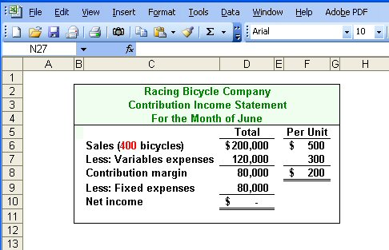
The Contribution Approach
If Racing sells 400 units in a month, it will be operating at the break-even point.
Notes:
3-<number>
If Racing sells 400 units a month, it will be operating at the break-even point. Let’s see what happens if Racing sells one more bike or a total of 401 bikes.

Slide 8
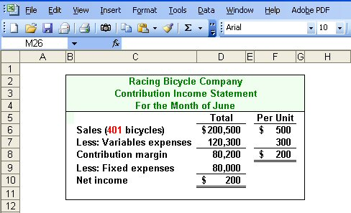
The Contribution Approach
If Racing sells one more bike (401 bikes), net
operating income will increase by $200.
Notes:
3-<number>
You can see that the sale of one unit above the break-even point yields net income of $200 for Racing Bicycle.

Slide 9

The Contribution Approach
We do not need to prepare an income statement to estimate profits at a particular sales volume. Simply multiply the number of units sold above break-even by the contribution margin per unit.
If Racing sells 430 bikes, its net income will be $6,000.
Notes:
3-<number>
If we develop equations to calculate break-even and net income, we will not have to prepare an income statement to determine what net income will be at any level of sales. For example, we know that if Racing Bicycle sells four hundred thirty bikes, net income will be $6,000. The company will sell 30 bikes above the break-even unit sales and the contribution margin is $200 per bike. So, we multiply 30 bikes times $200 per bike and get net income of $6,000.

Slide 10
Learning Objective 2
Prepare and interpret a cost-volume-profit (CVP) graph.
Notes:
3-<number>
Learning objective number 2 is to prepare and interpret a cost-volume-profit (CVP) graph.

Slide 11
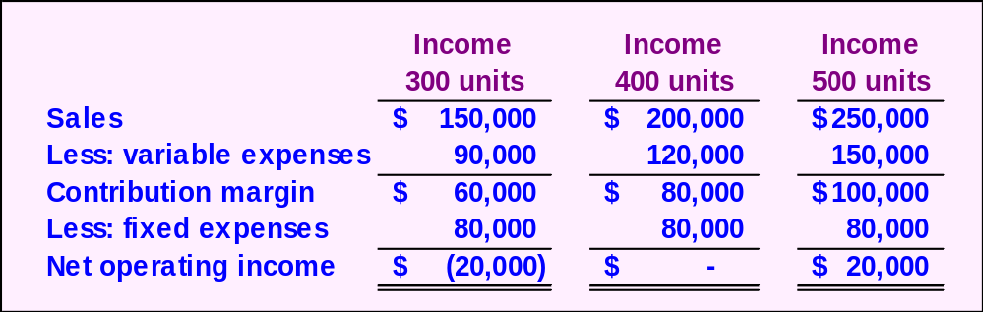
CVP Relationships in Graphic Form
The relationship among revenue, cost, profit and volume can be expressed graphically by preparing a CVP graph. Racing developed contribution margin income statements at 300, 400, and 500 units sold. We will use this information to prepare the CVP graph.
Notes:
3-<number>
The relationship among revenue, cost, profit and volume can be expressed graphically by preparing a cost-volume-profit (CVP) graph. To illustrate, we will use contribution income statements for Racing Bicycle Company at 300, 400, and 500 units sold.

Slide 12
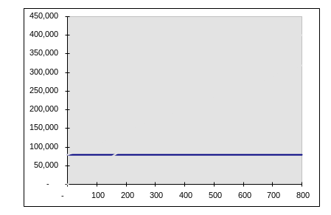
CVP Graph
Dollars
In a CVP graph, unit volume is usually represented on the horizontal (X) axis and dollars on the vertical (Y) axis.
Units
Notes:
3-<number>
In a CVP graph, unit volume is usually represented on the horizontal (X) axis and dollars on the vertical (Y) axis. Using this convention, a CVP graph can be prepared in three steps.

Slide 13
CVP Graph
Dollars
Fixed Expenses
Units
Notes:
3-<number>
The first step begins by drawing a line parallel to the volume axis to represent total fixed expenses of $80,000.

Slide 14
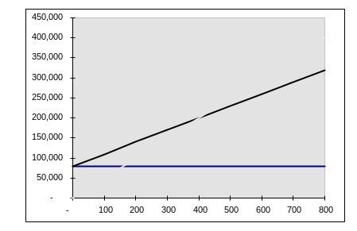
CVP Graph
Dollars
Total Expenses
Fixed Expenses
Units
Notes:
3-<number>
Next, choose some sales volume (for example, 500 units) and plot the point representing total expenses (e.g., fixed and variable) at that sales volume. Draw a line through the data point back to where the fixed expenses line intersects the dollar axis.

Slide 15
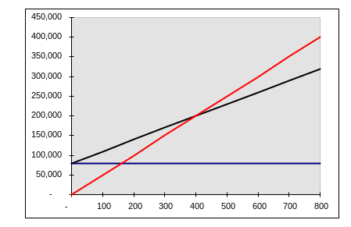
CVP Graph
Total Sales
Dollars
Total Expenses
Fixed Expenses
Units
Notes:
3-<number>
Finally, choose some sales volume (for example, 500 units) and plot the point representing total sales dollars at the chosen activity level. Draw a line through the data point back to the origin.

Slide 16
CVP Graph
Break-even point
(400 units or $200,000 in sales)
Profit Area
Dollars
Loss Area
Units
Notes:
3-<number>
The break-even point is where the total revenue and total expenses lines intersect. In the case of Racing Bicycle, break-even is 400 bikes sold, or sales revenue of $200,000. The profit or loss at any given sales level is measured by the vertical distance between the total revenue and the total expenses lines.

Slide 17
Learning Objective 3
Use the contribution margin ratio (CM ratio) to compute changes in contribution margin and net operating income resulting from changes in sales volume.
Notes:
3-<number>
Learning objective number 3 is to use the contribution margin ratio (CM ratio) to compute changes in contribution margin and net operating income resulting from changes in sales volume.

Slide 18
Contribution Margin Ratio
The contribution margin ratio is:
For Racing Bicycle Company the ratio is:
Total CM
Total sales
CM Ratio =
$80,000
$200,000
= 40%
Each $1.00 increase in sales results in a total contribution margin increase of 40¢.
Notes:
3-<number>
We can calculate the contribution margin ratio of Racing Bicycle by dividing total contribution by total sales. In the case of Racing Bicycle, the contribution margin ratio is 40%. This means that for each dollar increase in sales the company will produce 40¢ in contribution margin.

Slide 19
Contribution Margin Ratio
Or, in terms of units, the contribution margin ratio is:
For Racing Bicycle Company the ratio is:
Unit CM
Unit selling price
CM Ratio =
$200
$500
= 40%
Notes:
3-<number>
The CM ratio can also be calculated by dividing the contribution margin per unit by the selling price per unit.

Slide 20
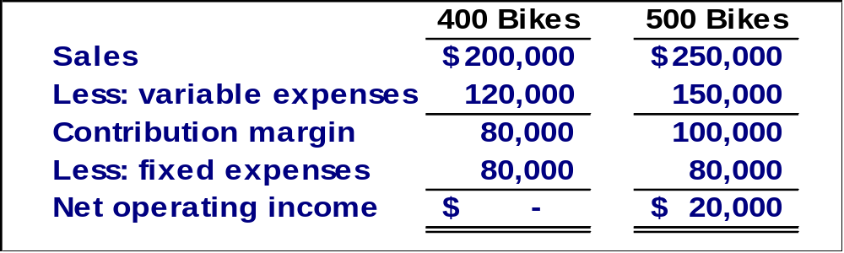
Contribution Margin Ratio
A $50,000 increase in sales revenue
results in a $20,000 increase in CM.
($50,000 × 40% = $20,000)
Notes:
3-<number>
Let’s see how we can use the contribution margin ratio to look at the contribution margin income statement of Racing Bicycle in a little different way. If RBC is able to increase its sales by $50,000 it will increase contribution margin by $20,000, that is, $50,000 times 40%.

Slide 21
Quick Check ✓
Coffee Klatch is an espresso stand in a downtown office building. The average selling price of a cup of coffee is $1.49 and the average variable expense per cup is $0.36. The average fixed expense per month is $1,300. 2,100 cups are sold each month on average. What is the CM Ratio for Coffee Klatch?
  a. 1.319
  b. 0.758
  c. 0.242
  d. 4.139
Notes:
3-<number>
Can you calculate the contribution margin ratio for Coffee Klatch? The calculation may take a minute or so to complete.

Slide 22
Quick Check ✓
Coffee Klatch is an espresso stand in a downtown office building. The average selling price of a cup of coffee is $1.49 and the average variable expense per cup is $0.36. The average fixed expense per month is $1,300. 2,100 cups are sold each month on average. What is the CM Ratio for Coffee Klatch?
  a. 1.319
  b. 0.758
  c. 0.242
  d. 4.139
Unit contribution margin
Unit selling price
CM Ratio =
($1.49-$0.36)
$1.49
=
$1.13
$1.49
=
= 0.758
Notes:
3-<number>
How did you do? The CM ratio is 75.8%.

Slide 23
Learning Objective 4
Show the effects on contribution margin of changes in variable costs, fixed costs, selling price, and volume.
Notes:
3-<number>
Learning objective number 4 is to show the effects on contribution margin of changes in variable costs, fixed costs, selling price, and volume.

Slide 24

Changes in Fixed Costs and Sales Volume
What is the profit impact if Racing can increase unit sales from 500 to 540 by increasing the monthly advertising budget by $10,000?
Notes:
3-<number>
Let’s assume that the management of RBC believes it can increase unit sales from 500 to 540 if it spends $10,000 on advertising. Would you recommend that the advertising campaign be undertaken? See if you can solve this problem before going to the next screen.

Slide 25
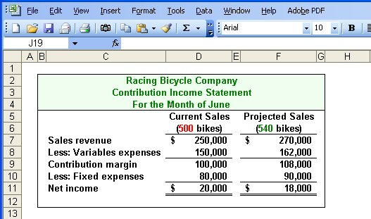
Changes in Fixed Costs and Sales Volume
$80,000 + $10,000 advertising = $90,000
Sales increased by $20,000, but net operating income decreased by $2,000.
Notes:
3-<number>
As you can see, even if sales revenue increases to $270,000, RBC will experience a $12,000 increase in variable costs and a $10,000 increase in fixed costs (the new advertising campaign). As a result, net income will actually drop by $2,000. The advertising campaign certainly would not be a good idea. We can help management see the problem before any additional monies are spent.

Slide 26
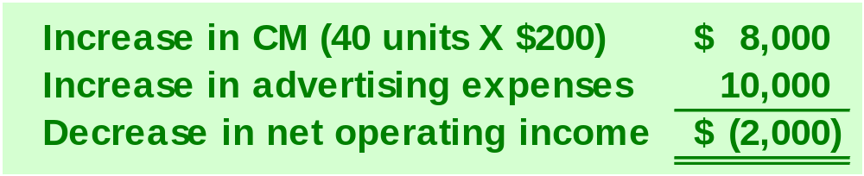

Changes in Fixed Costs and Sales Volume
The Shortcut Solution
Notes:
3-<number>
Here is a shortcut approach to looking at the problem. You can see that an increase in contribution margin is more than offset by the increased advertising costs.

Slide 27
Change in Variable Costs and Sales Volume
What is the profit impact if Racing can use higher quality raw materials, thus increasing variable costs per unit by $10, to generate an increase in unit sales from 500 to 580?
Notes:
3-<number>
Management at RBC believes that using higher quality raw materials will result in an increase in sales from 500 to 580. The higher quality raw materials will lead to a $10 increase in variable costs per unit. Would you recommend the use of the higher quality raw materials?

Slide 28
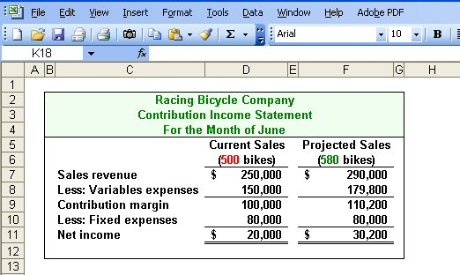
Change in Variable Costs and Sales Volume
580 units × $310 variable cost/unit = $179,800
Sales increase by $40,000, and net operating income increases by $10,200.
Notes:
3-<number>
As you can see, revenues will increase by $40,000 (80 bikes times $500 per bike), and variable costs will increase by $29,800. Contribution margin will increase by $10,200. With no change in fixed costs, net income will also increase by $10,200.
The use of higher quality raw materials appears to be a profitable idea.

Slide 29
Change in Fixed Cost, Sales Price and Volume
What is the profit impact if Racing (1) cuts its selling price $20 per unit, (2) increases its advertising budget by $15,000 per month, and (3) increases sales from 500 to 650 units per month?
Notes:
3-<number>
Here is a more complex situation. What is the profit impact if RBC: (1) cuts its selling price $20 per unit, (2) increases its advertising budget by $15,000 per month, and (3) increases sales from 500 to 650 units per month?

Slide 30
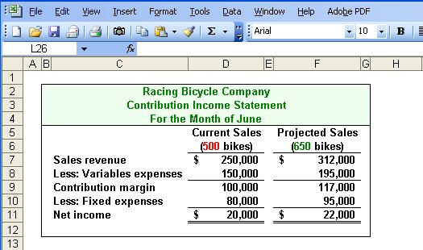
Change in Fixed Cost, Sales Price and Volume
Sales increase by $62,000, fixed costs increase by $15,000, and net operating income increases by $2,000.
Notes:
3-<number>
This appears to be a good plan because net income will increase by $2,000. Take a few minutes and analyze the change in sales revenue, variable expenses and fixed expenses.

Slide 31
Change in Variable Cost, Fixed Cost and Sales Volume
What is the profit impact if Racing (1) pays a $15 sales commission per bike sold instead of paying salespersons flat salaries that currently total $6,000 per month, and (2) increases unit sales from 500 to 575 bikes?
Notes:
3-<number>
Here is another complex question involving cost-volume-profit relationships. What is the profit impact if RBC: (1) pays a $15 sales commission per bike sold instead of paying salespersons flat salaries that currently total $6,000 per month, and (2) increases unit sales from 500 to 575 bikes?

Slide 32
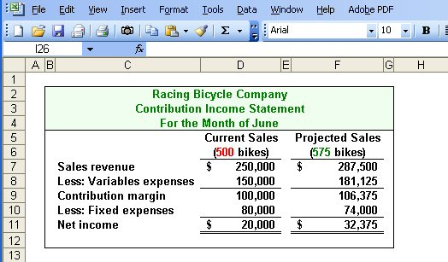
Change in Variable Cost, Fixed Cost and Sales Volume
Sales increase by $37,500, variable costs increase by $31,125, but fixed expenses decrease by $6,000.
Notes:
3-<number>
Net income increased by $12,375. Notice that sales revenue and variable expenses increased as well. Fixed expenses were decreased as a result of making sales commissions variable in nature.
How did you do? We hope you are beginning to see the potential power of CVP analysis.

Slide 33
Change in Regular Sales Price
If Racing has an opportunity to sell 150 bikes to a wholesaler without disturbing sales to other customers or fixed expenses, what price would it quote to the wholesaler if it wants to increase monthly profits by $3,000?
Notes:
3-<number>
Suppose RBC has a one-time opportunity to sell 150 bikes to a wholesaler. There would be no change in the cost structure as a result of this sale. Racing wants the one-time sale to produce a profit of $3,000. What selling price should RBC quote to the wholesaler?

Slide 34
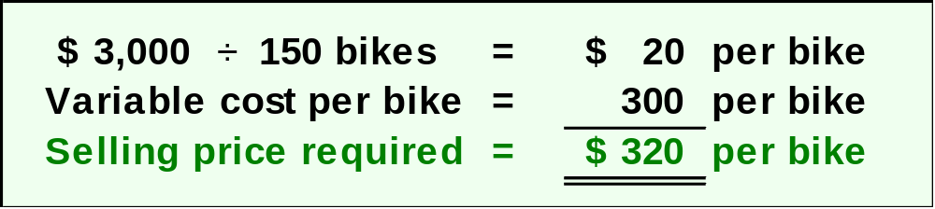
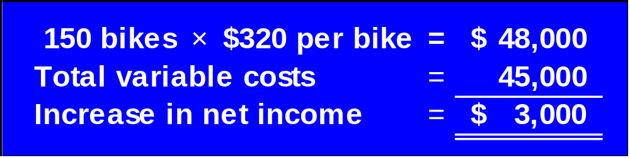

Change in Regular Sales Price
Notes:
3-<number>
If we desire a profit of $3,000 on the sale of 150 bikes, we must have a profit of $20 per bike. The variable expenses associated with each bike are $300, so we would quote a selling price of $320.
You can see the proof of the quote in the blue schedule.

Slide 35
Learning Objective 5
Compute the break-even point in unit sales and sales dollars.
Notes:
3-<number>
Learning objective number 5 is to compute the break-even point in unit sales and sales dollars.

Slide 36

Break-Even Analysis
Break-even analysis can be approached in two ways:
  Equation method
  Contribution margin method
Notes:
3-<number>
We can accomplish break-even analysis in one of two ways. We can use the equation method or the contribution margin method. We get the same results regardless of the method selected. You may prefer one method over the other. It’s a personal choice, but be aware there are some problems associated with either method. Some are easier to solve using the equation method, while others can be quickly solved using the contribution margin method.

Slide 37
Equation Method
Profits = (Sales – Variable expenses) – Fixed expenses
OR
Sales = Variable expenses + Fixed expenses + Profits
At the break-even point
profits equal zero
Notes:
3-<number>
The equation method is based on the contribution approach income statement. The equation can be stated in one of two ways:
Profits equal Sales less Variable expenses, less Fixed Expenses, or
Sales equal Variable expenses plus Fixed expenses plus Profits
Remember that at the break-even point profits are equal to zero.

Slide 38
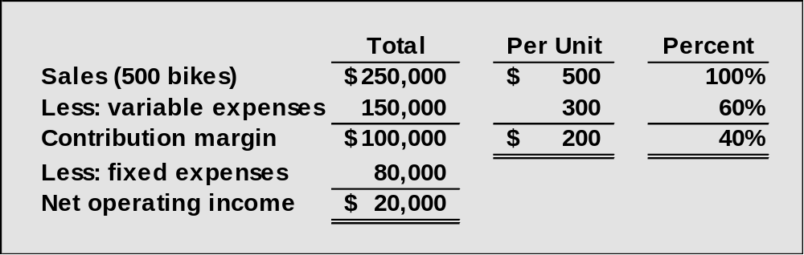
Break-Even Analysis
Here is the information from Racing Bicycle Company:
Notes:
3-<number>
Here is some information provided by Racing Bicycle that we will use to solve some problems. We have the contribution margin income statement, the selling price and variable expenses per unit, and the contribution margin ratio.

Slide 39
Equation Method
We calculate the break-even point as follows:
Sales = Variable expenses + Fixed expenses + Profits
$500Q = $300Q + $80,000 + $0
Where:
Q = Number of bikes sold
$500 = Unit selling price
$300 = Unit variable expense
$80,000 = Total fixed expense
Notes:
3-<number>
The break-even point in units is determined by creating the equation as shown, where Q is the number of bikes sold, $500 is the unit selling price, $300 is the unit variable expense, and $80,000 is the total fixed expense.
We need to solve for Q.

Slide 40
Equation Method
We calculate the break-even point as follows:
Sales = Variable expenses + Fixed expenses + Profits
$500Q = $300Q + $80,000 + $0
$200Q = $80,000
Q = $80,000 ÷ $200 per bike
Q = 400 bikes
Notes:
3-<number>
Solving this equation shows that the break-even point in units is 400 bikes. We want to be careful with the algebra when we group terms.

Slide 41
Equation Method
The equation can be modified to calculate the break-even point in sales dollars.
Sales = Variable expenses + Fixed expenses + Profits
X = 0.60X + $80,000 + $0
Where:
X = Total sales dollars
0.60 = Variable expenses as a % of sales $80,000 = Total fixed expenses
Notes:
3-<number>
The equation can be modified as shown to calculate the break-even point in sales dollars. In this equation, X is total sales dollars, point six zero (or 60%) is the variable expense as a percentage of sales, and $80,000 is the total fixed expense.
We need to solve for X.

Slide 42
Equation Method
The equation can be modified to calculate the break-even point in sales dollars.
Sales = Variable expenses + Fixed expenses + Profits
X = 0.60X + $80,000 + $0
0.40X = $80,000
X = $80,000 ÷ 0.40
X = $200,000
Notes:
3-<number>
Solving this equation shows that the break-even point is sales dollars is $200,000. Once again, be careful when you combine the X values in the equation.

Slide 43
Contribution Margin Method
The contribution margin method has two key equations.
Break-even point
in units sold
Fixed expenses
CM per unit
=
Break-even point in
total sales dollars
Fixed expenses
CM ratio
=
Notes:
3-<number>
The contribution margin method has two key equations:
Break-even point in units sold equals Fixed expenses divided by CM per unit, and
Break-even point in sales dollars equals Fixed expenses divided by CM ratio.

Slide 44
Contribution Margin Method
Let’s use the contribution margin method to calculate the break-even point in total sales dollars at Racing.
Break-even point in
total sales dollars
Fixed expenses
CM ratio
=
$80,000
40%
= $200,000 break-even sales
Notes:
3-<number>
Part I
Let’s use the contribution margin method to calculate break-even in total sales dollars.
Part II
The break-even sales revenue is $200,000.

Slide 45
Quick Check ✓
Coffee Klatch is an espresso stand in a downtown office building. The average selling price of a cup of coffee is $1.49 and the average variable expense per cup is $0.36. The average fixed expense per month is $1,300. 2,100 cups are sold each month on average. What is the break-even sales in units?
  872 cups
  b. 3,611 cups
  c. 1,200 cups
  d. 1,150 cups
Notes:
3-<number>
Now use the contribution margin approach to calculate the break-even point in cups of coffee sold.

Slide 46
Quick Check ✓
Coffee Klatch is an espresso stand in a downtown office building. The average selling price of a cup of coffee is $1.49 and the average variable expense per cup is $0.36. The average fixed expense per month is $1,300. 2,100 cups are sold each month on average. What is the break-even sales in units?
  872 cups
  b. 3,611 cups
  c. 1,200 cups
  d. 1,150 cups
Fixed expenses
CM per Unit
Break-even =
$1,300
$1.49/cup - $0.36/cup
=
$1,300
$1.13/cup
=
= 1,150 cups
Notes:
3-<number>
The contribution margin per cup of coffee is $1.13. The number of cups to sell to reach break-even is 1,150.

Slide 47
Quick Check ✓
Coffee Klatch is an espresso stand in a downtown office building. The average selling price of a cup of coffee is $1.49 and the average variable expense per cup is $0.36. The average fixed expense per month is $1,300. 2,100 cups are sold each month on average. What is the break-even sales in dollars?
  a. $1,300
  b. $1,715
  c. $1,788
  d. $3,129
Notes:
3-<number>
Let’s calculate the break-even in sales dollars for Coffee Klatch.

Slide 48
Quick Check ✓
Coffee Klatch is an espresso stand in a downtown office building. The average selling price of a cup of coffee is $1.49 and the average variable expense per cup is $0.36. The average fixed expense per month is $1,300. 2,100 cups are sold each month on average. What is the break-even sales in dollars?
  a. $1,300
  b. $1,715
  c. $1,788
  d. $3,129
Break-even
sales
Fixed expenses
CM Ratio
=
$1,300
0.758
=
= $1,715
Notes:
3-<number>
With a contribution margin ratio of 75.8% (rounded), break-even sales revenue is $1,715.

Slide 49
Learning Objective 6
Determine the level of sales needed to achieve a desired target profit.
Notes:
3-<number>
Learning objective number 6 is to determine the level of sales needed to achieve a desired target profit.

Slide 50
Target Profit Analysis
The equation and contribution margin methods can be used to determine the sales volume needed to achieve a target profit.
Suppose Racing Bicycle Company wants to know how many bikes must be sold to earn a profit of $100,000.
Notes:
3-<number>
We can use either method to determine the revenue or units needed to achieve a target level of profit.
Suppose RBC wants to earn net income of $100,000. How many bikes must the company sell to achieve this profit level?

Slide 51
The CVP Equation Method
Sales = Variable expenses + Fixed expenses + Profits
$500Q = $300Q + $80,000 + $100,000
$200Q = $180,000
Q = 900 bikes
Notes:
3-<number>
Instead of setting profit to zero like we do in a break-even analysis, we set the profit level to $100,000. Solving for Q, we see that the company will have to sell 900 bikes to achieve the desired profit level.

Slide 52
The Contribution Margin Approach
The contribution margin method can be used to determine that 900 bikes must be sold to earn the target profit of $100,000.
Unit sales to attain
the target profit
Fixed expenses + Target profit
CM per unit
=
$80,000 + $100,000
$200/bike
= 900 bikes
Notes:
3-<number>
A quicker way to solve this problem is to add the desired profits to the fixed cost and divide the total by the contribution margin per unit. Notice we get the same result of 900 bikes.

Slide 53
Quick Check ✓
Coffee Klatch is an espresso stand in a downtown office building. The average selling price of a cup of coffee is $1.49 and the average variable expense per cup is $0.36. The average fixed expense per month is $1,300. How many cups of coffee would have to be sold to attain target profits of $2,500 per month?
  a. 3,363 cups
  b. 2,212 cups
  c. 1,150 cups
  d. 4,200 cups
Notes:
3-<number>
The Coffee Klatch wants to earn a monthly profit of $2,500. How many cups of coffee must the company sell to reach this profit goal?

Slide 54
Quick Check ✓
Unit sales
to attain
target profit
Fixed expenses + Target profit
Unit CM
=
Coffee Klatch is an espresso stand in a downtown office building. The average selling price of a cup of coffee is $1.49 and the average variable expense per cup is $0.36. The average fixed expense per month is $1,300. How many cups of coffee would have to be sold to attain target profits of $2,500 per month?
  a. 3,363 cups
  b. 2,212 cups
  c. 1,150 cups
  d. 4,200 cups
$1,300 + $2,500
$1.49 - $0.36
=
$3,800
$1.13
=
= 3,363 cups
Notes:
3-<number>
We add the desired profit to the fixed cost and divide by the unit contribution of $1.13. The company must sell 3,363 cups of coffee to reach its profit goal.

Slide 55
Learning Objective 7
Compute the margin of safety and explain its significance.
Notes:
3-<number>
Learning objective number 7 is to compute the margin of safety and explain its significance.

Slide 56
The Margin of Safety
The margin of safety is the excess of budgeted (or actual) sales over the break-even volume of sales.
Margin of safety = Total sales - Break-even sales
Let’s look at Racing Bicycle Company and determine the margin of safety.
Notes:
3-<number>
The margin of safety helps management assess how far above or below the break-even point the company is currently operating. To calculate the margin of safety, we take total current sales and subtract break-even sales.
Let’s calculate the margin of safety for RBC.

Slide 57
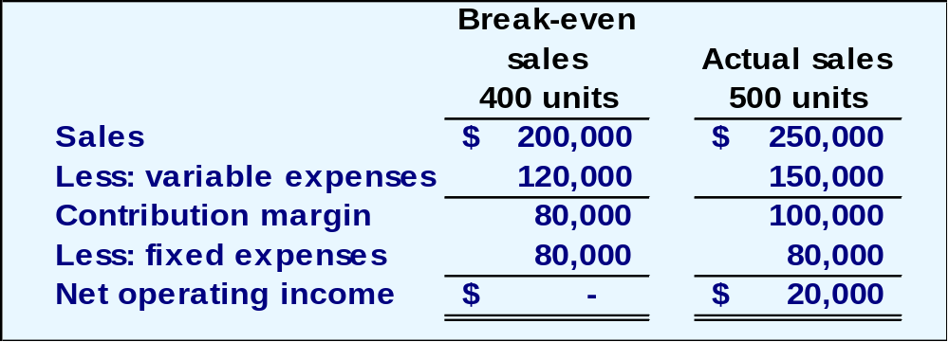
The Margin of Safety
If we assume that Racing Bicycle Company has actual sales of $250,000, given that we have already determined the break-even sales to be $200,000, the margin of safety is $50,000 as shown.
Notes:
3-<number>
RBC is currently selling 500 bikes and producing total sales revenue of $250,000. Sales at the break-even point are $200,000, so the company’s margin of safety is $50,000.

Slide 58
The Margin of Safety
The margin of safety can be expressed as 20% of sales.
($50,000 ÷ $250,000)
Notes:
3-<number>
We can express the margin of safety as a percent of sales. In the case of RBC, the margin of safety is 20% ($50,000 divided by $250,000).

Slide 59
The Margin of Safety
The margin of safety can be expressed in terms of the number of units sold. The margin of safety at Racing is $50,000, and each bike sells for $500.
Margin of
Safety in units
$50,000
$500
=
= 100 bikes
Notes:
3-<number>
The margin of safety can be expressed in terms of the number of units sold. RBC’s margin of safety is 100 bikes.

Slide 60
Quick Check ✓
Coffee Klatch is an espresso stand in a downtown office building. The average selling price of a cup of coffee is $1.49 and the average variable expense per cup is $0.36. The average fixed expense per month is $1,300. 2,100 cups are sold each month on average. What is the margin of safety?
  a. 3,250 cups
  b. 950 cups
  c. 1,150 cups
  d. 2,100 cups
Notes:
3-<number>
Let’s see if you can calculate the margin of safety in cups of coffee for the Coffee Klatch.

Slide 61
Quick Check ✓
Coffee Klatch is an espresso stand in a downtown office building. The average selling price of a cup of coffee is $1.49 and the average variable expense per cup is $0.36. The average fixed expense per month is $1,300. 2,100 cups are sold each month on average. What is the margin of safety?
  a. 3,250 cups
  b. 950 cups
  c. 1,150 cups
  d. 2,100 cups
Margin of safety = Total sales – Break-even sales
= 2,100 cups – 1,150 cups
= 950 cups
or
Margin of safety percentage
950 cups
2,100 cups
=
= 45%
Notes:
3-<number>
The margin of safety is 950 cups, or we can calculate the margin of safety as 45%.

Slide 62

Cost Structure and Profit Stability
Cost structure refers to the relative proportion of fixed and variable costs in an organization. Managers often have some latitude in determining their organization’s cost structure.
Notes:
3-<number>
A company’s cost structure refers to the relative proportion of fixed and variable expenses. Some companies have high fixed expenses relative to variable expenses. Do you remember our discussion of utility companies? Because of the heavy investment in property, plant and equipment, many utility companies have a high proportion of fixed costs.

Slide 63
Cost Structure and Profit Stability
There are advantages and disadvantages to high fixed cost (or low variable cost) and low fixed cost (or high variable cost) structures.
An advantage of a high fixed
cost structure is that income
will be higher in good years
compared to companies
with lower proportion of
fixed costs.
A disadvantage of a high fixed
cost structure is that income
will be lower in bad years
compared to companies
with lower proportion of
fixed costs.
Notes:
3-<number>
Generally, companies with a high fixed cost structure will show higher net income in good years than companies with lower fixed cost structures. Just the opposite is true in bad years. Companies with low fixed cost structures enjoy greater stability in income across good and bad years.

Slide 64
Learning Objective 8
Compute the degree of operating leverage at a particular level of sales and explain how it can be used to predict changes in net operating income.
Notes:
3-<number>
Learning objective number 8 is to compute the degree of operating leverage at a particular level of sales and explain how it can be used to predict changes in net operating income.

Slide 65
Operating Leverage
A measure of how sensitive net operating income is to percentage changes in sales.
Degree of
operating leverage
Contribution margin
Net operating income
=
Notes:
3-<number>
The degree of operating leverage is a measure, at any given level of sales, of how a percentage change in sales volume will affect profits. It is computed by dividing contribution margin by net operating income.
Let’s look at Racing Bicycle.

Slide 66
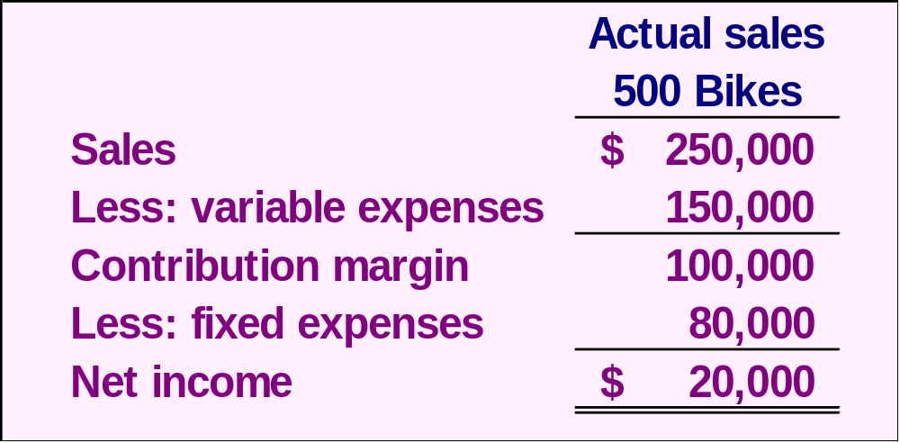
Operating Leverage
At Racing, the degree of operating leverage is 5.
$100,000
$20,000
= 5
Notes:
3-<number>
Recall that Racing is currently selling 500 bikes and producing net income of $20,000. Contribution margin is $100,000.
Operating leverage is 5. We determine this by dividing the $100,000 contribution by net income of $20,000.
Now that we calculated the degree of operating leverage for RBC, let’s see exactly what this means to management.

Slide 67
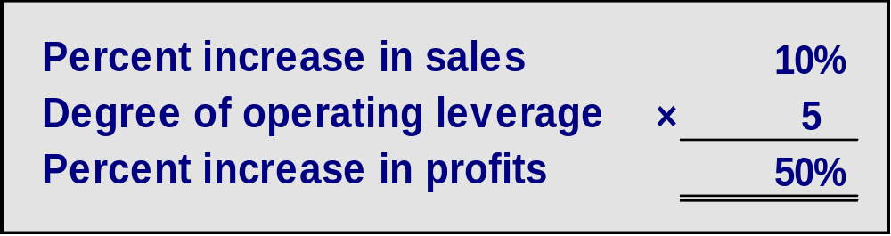
Operating Leverage
With an operating leverage of 5, if Racing increases its sales by 10%, net operating income would increase by 50%.
Here’s the verification!
Notes:
3-<number>
If Racing is able to increase sales by 10%, net income will increase by 50%. We multiply the percentage increase in sales by the degree of operating leverage. Let’s verify the 50% increase in profit.

Slide 68
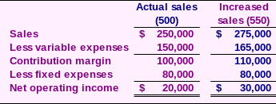
Operating Leverage
10% increase in sales from
$250,000 to $275,000 . . .
. . . results in a 50% increase in
income from $20,000 to $30,000.
Notes:
3-<number>
A 10% increase in sales would increase bike sales from the current level of 500 to 550. Look at the contribution margin income statement and notice that income increased from $20,000 to $30,000. That $10,000 increase in net income is a 50% increase.
So it is true that a 10% increase in sales results in a 50% in net income. This is powerful information for a manager to have.

Slide 69
Quick Check ✓
Coffee Klatch is an espresso stand in a downtown office building. The average selling price of a cup of coffee is $1.49 and the average variable expense per cup is $0.36. The average fixed expense per month is $1,300. 2,100 cups are sold each month on average. What is the operating leverage?
  a. 2.21
  b. 0.45
  c. 0.34
  d. 2.92
Notes:
3-<number>
See if you can calculate the degree of operating leverage for the Coffee Klatch.

Slide 70
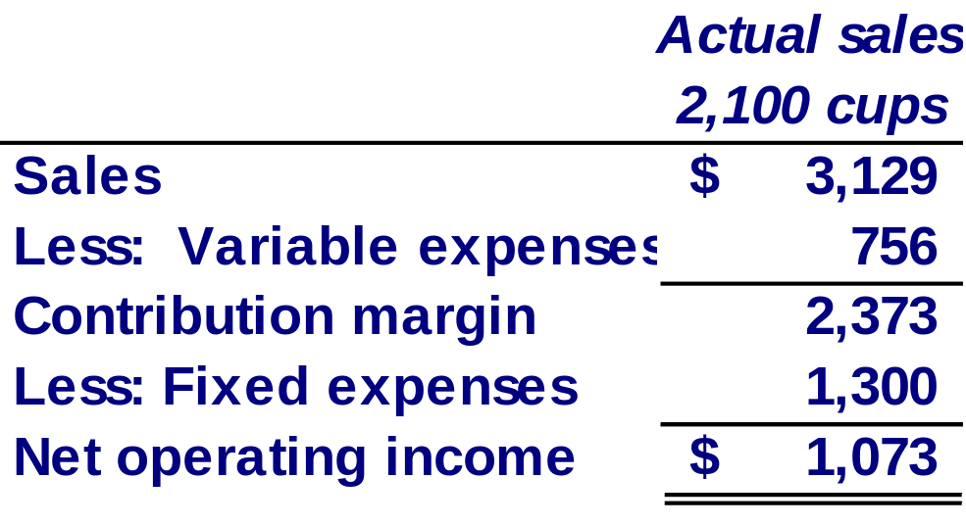
Quick Check ✓
Coffee Klatch is an espresso stand in a downtown office building. The average selling price of a cup of coffee is $1.49 and the average variable expense per cup is $0.36. The average fixed expense per month is $1,300. 2,100 cups are sold each month on average. What is the operating leverage?
  a. 2.21
  b. 0.45
  c. 0.34
  d. 2.92
Operating leverage
Contribution margin
Net operating income
=
$2,373
$1,073
=
= 2.21
Notes:
3-<number>
The computations took a while to complete, didn’t they. You can see that operating leverage is 2.21.

Slide 71
Quick Check ✓
At Coffee Klatch the average selling price of a cup of coffee is $1.49, the average variable expense per cup is $0.36, the average fixed expense per month is $1,300 and an average of 2,100 cups are sold each month.
If sales increase by 20%, by how much should net operating income increase?
  a. 30.0%
  b. 20.0%
  c. 22.1%
  d. 44.2%
Notes:
3-<number>
If the Coffee Klatch is able to increase sales by 20%, what will be the increase in net income?

Slide 72
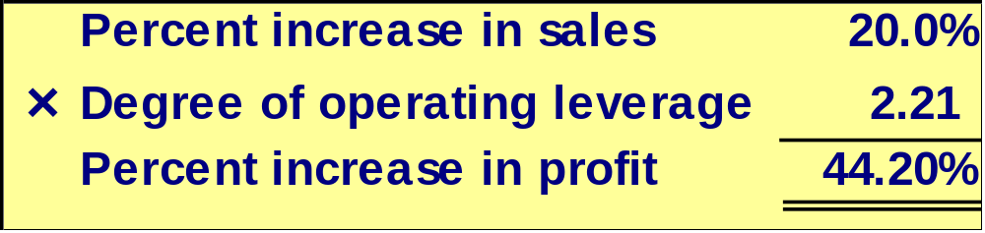
Quick Check ✓
At Coffee Klatch the average selling price of a cup of coffee is $1.49, the average variable expense per cup is $0.36, the average fixed expense per month is $1,300 and an average of 2,100 cups are sold each month.
If sales increase by 20%, by how much should net operating income increase?
  a. 30.0%
  b. 20.0%
  c. 22.1%
  d. 44.2%
Notes:
3-<number>
You are right. The increase in net income is 44.2%.

Slide 73
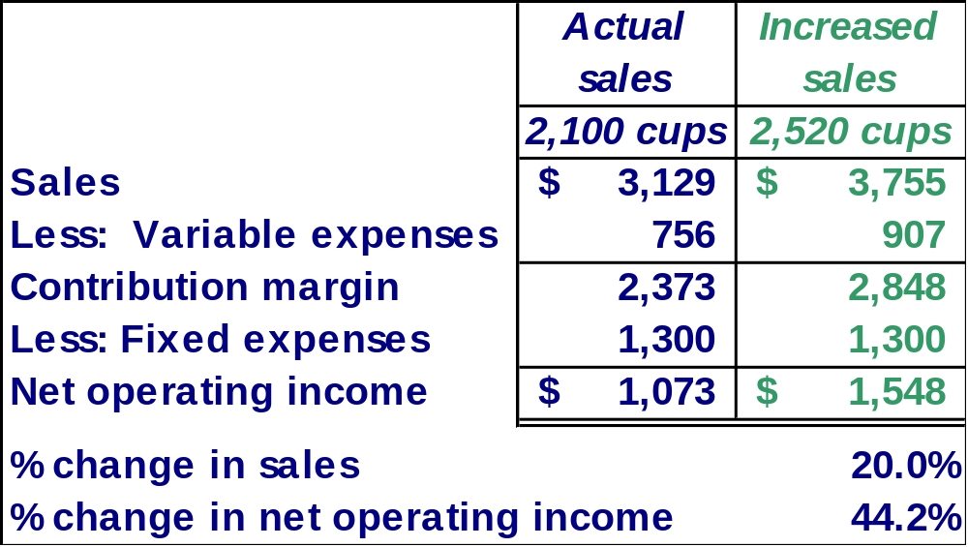
Verify Increase in Profit
Notes:
3-<number>
Here is our verification of the increase in net income. Take a few minutes and make sure you understand how we calculated all the numbers.

Slide 74
Structuring Sales Commissions
Companies generally compensate salespeople by paying them either a commission based on sales or a salary plus a sales commission. Commissions based on sales dollars can lead to lower profits in a company.
Let’s look at an example.
Notes:
3-<number>
You have probably heard that salespersons can be compensated on a commission basis. The commission is usually based on sales revenue generated. Some salespersons work on a salary plus commission.
When salespersons are paid a commission based on sales dollars generated, the income statement impact may not be fully understood.
Let’s look at an example.

Slide 75

Structuring Sales Commissions
Pipeline Unlimited produces two types of surfboards, the XR7 and the Turbo. The XR7 sells for $100 and generates a contribution margin per unit of $25. The Turbo sells for $150 and earns a contribution margin per unit of $18.
The sales force at Pipeline Unlimited is compensated based on sales commissions.
Notes:
3-<number>
Pipeline Unlimited produces two surfboards. The XR7 model sells for $100 dollars and has a contribution margin per unit of $25. The second surfboard, the Turbo model, sells for $150 and has a contribution margin of $18 per unit sold. The sales force at Pipeline is paid on sales commissions.

Slide 76
Structuring Sales Commissions
If you were on the sales force at Pipeline, you would push hard to sell the Turbo even though the XR7 earns a higher contribution margin per unit.
To eliminate this type of conflict, commissions can be based on contribution margin rather than on selling price alone.
Notes:
3-<number>
If you were on the sales force, you would try to sell all the Turbo models you could because it has a higher selling price per unit. The problem is that the XR7 model produces a higher contribution margin to the company.
It might be a good idea for Pipeline to base its sales commissions on contribution margin rather than selling price alone.

Slide 77
Learning Objective 9
Compute the break-even point for a multiproduct company and explain the effects of shifts in the sales mix on contribution margin and the break-even point.
Notes:
3-<number>
Learning objective number 9 is to compute the break-even point for a multiproduct company and explain the effects of shifts in the sales mix on contribution margin and the break-even point.

Slide 78
The Concept of Sales Mix
Sales mix is the relative proportion in which a company’s products are sold.
Different products have different selling prices, cost structures, and contribution margins.
Let’s assume Racing Bicycle Company sells bikes and carts and that the sales mix between the two products remains the same.
Notes:
3-<number>
When a company sells more than one product, break-even analyses become more complex because of the relative mix of the products sold. Different products will have different selling prices, cost structures and contribution margins.
Let’s expand the product line at Racing Bicycle and see what impact this has on break-even. We are going to assume that the sales mix between the products remains the same in our example.

Slide 79
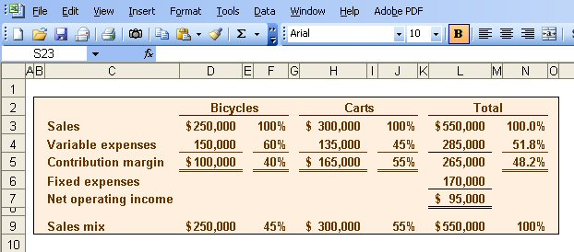
Multi-product break-even analysis
Racing Bicycle Co. provides the following information:
$265,000
$550,000
= 48.2% (rounded)
Notes:
3-<number>
Racing Bicycle sells both bikes and carts. Look at the contribution margin for each product. Notice that we subtract fixed expenses from the total contribution margin. We do not allocate the fixed costs to each product.
The sales mix shows that 45% of the company’s sales revenue comes from the sale of bikes and 55% comes from the sale of carts.
The combined contribution margin ratio is 48.2% (rounded). Let’s look at break-even.

Slide 80
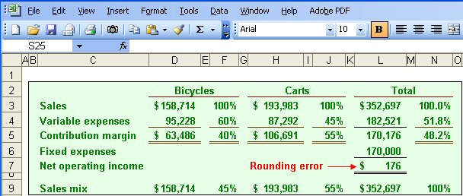
Multi-product break-even analysis
Break-even
sales
Fixed expenses
CM Ratio
=
$170,000
48.2%
=
= $352,697
Notes:
3-<number>
Part I
Break-even in sales dollars is $352,697. We calculate this amount in the normal way. We divide total fixed expenses of $170,000 by the combined contribution margin ratio.
Part II
We begin by allocating total break-even sales revenue to the two products. 45% of the total is assigned to the bikes and 55% to the carts.
The variable costs-by-product are determined by multiplying the variable expense percent times the assigned revenue. The contribution margin is the difference between the assigned revenue and the variable expenses. Once again, we subtract fixed expenses from the combined total contribution margin for the two products. Because we used a rounded contribution margin percent, we have a rounding error of $176.
Obviously, the more products a company has, the more complex the break-even analysis becomes.

Slide 81

Key Assumptions of CVP Analysis
Selling price is constant.
Costs are linear.
In multiproduct companies, the sales mix is constant.
In manufacturing companies, inventories do not change (units produced = units sold).
Notes:
3-<number>
Here are the four key assumptions of cost-volume-profit analysis. You are probably familiar with the first three by now. The forth assumption tells us that there can be no change in inventory levels. That is, all units produced are sold in the current period.

Slide 82

End of the Chapter
Notes:
3-<number>
End of chapter 6.

